Slide 1
Apple and Google Stocks Analysis in SQL
By sahil

Slide 2
objective :
The objective of this analysis is to perform an in-depth comparative study of Apple and Google stock data using SQL. It aims to:
Summarize key trading metrics (volume, price, return)
Compare performance between Apple and Google
Identify trends and anomalies across time
Use SQL joins, window functions, CTEs, and aggregations to derive actionable insights from historical stock prices

Slide 3
Dataset overview:
Column | Description
Date | The trading date on which the stock data was recorded.
Open | The price at which the stock started trading at the beginning of the day.
High | The highest price the stock reached during that trading day.
Low | The lowest price the stock dropped to during the trading day.
Close | The price at which the stock ended trading on that day.
Adj Close | The closing price adjusted for dividends, stock splits, and other factors.
Volume | The total number of shares traded on that particular day.

Slide 4
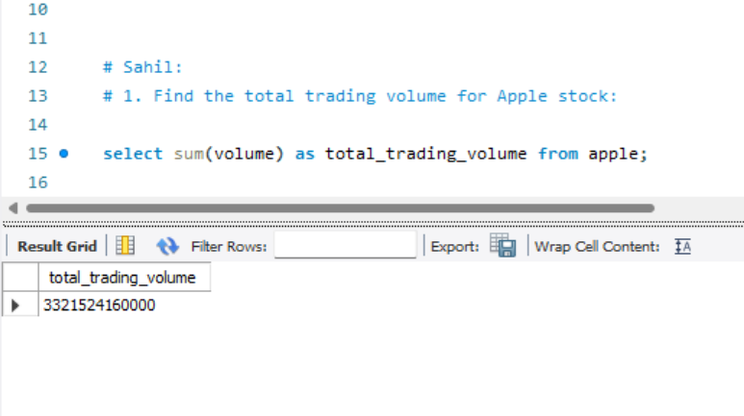

Slide 5
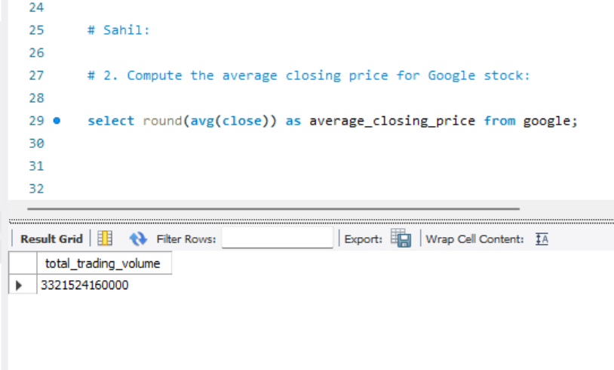

Slide 6
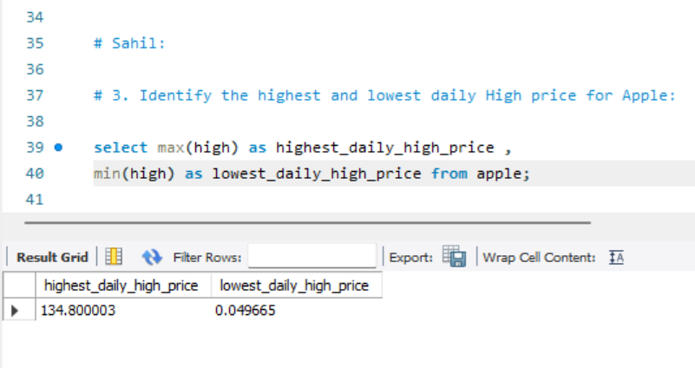

Slide 7
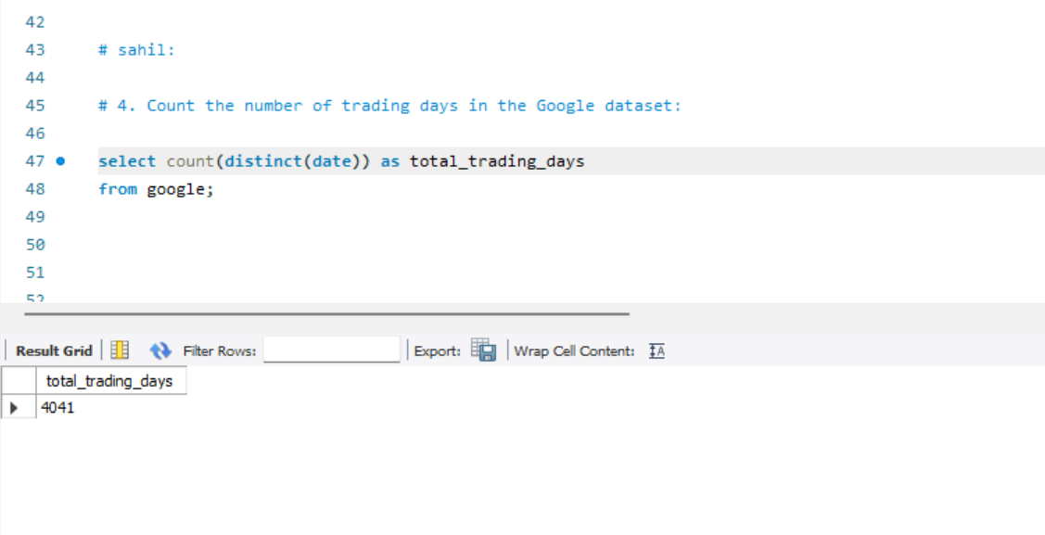

Slide 8
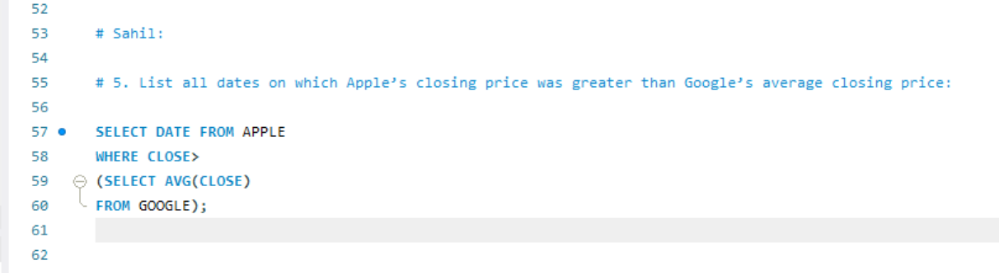

Slide 9
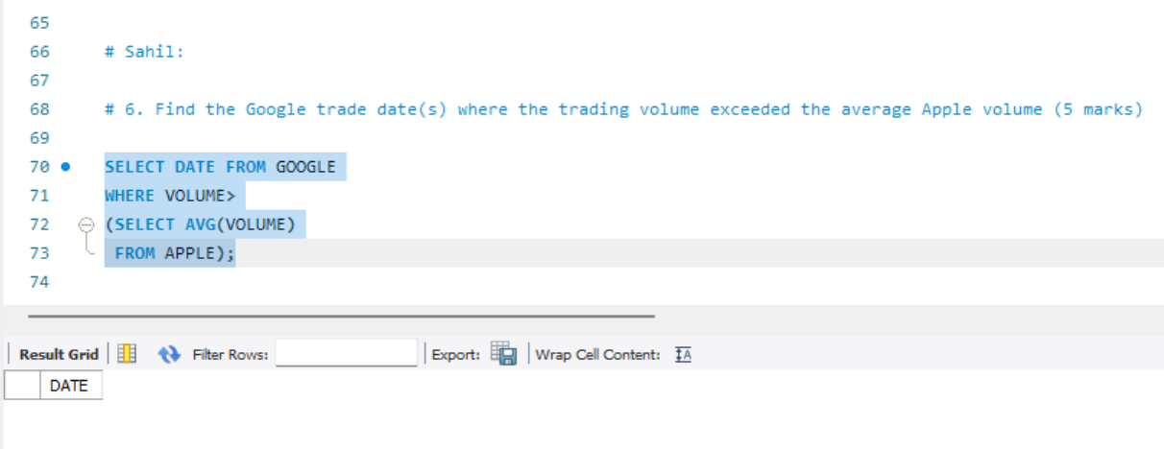

Slide 10
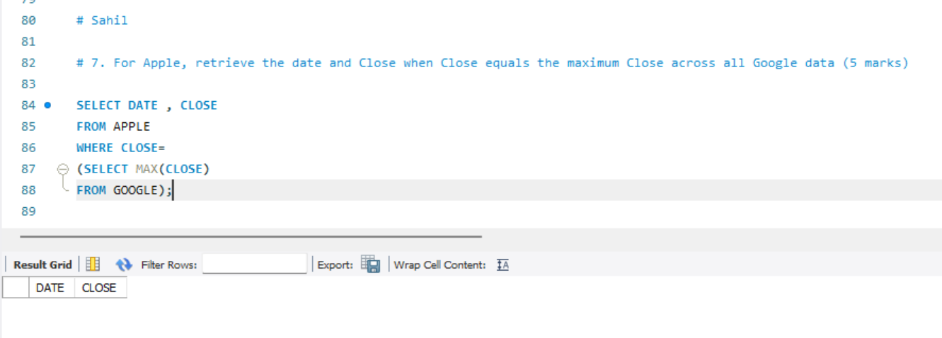

Slide 11
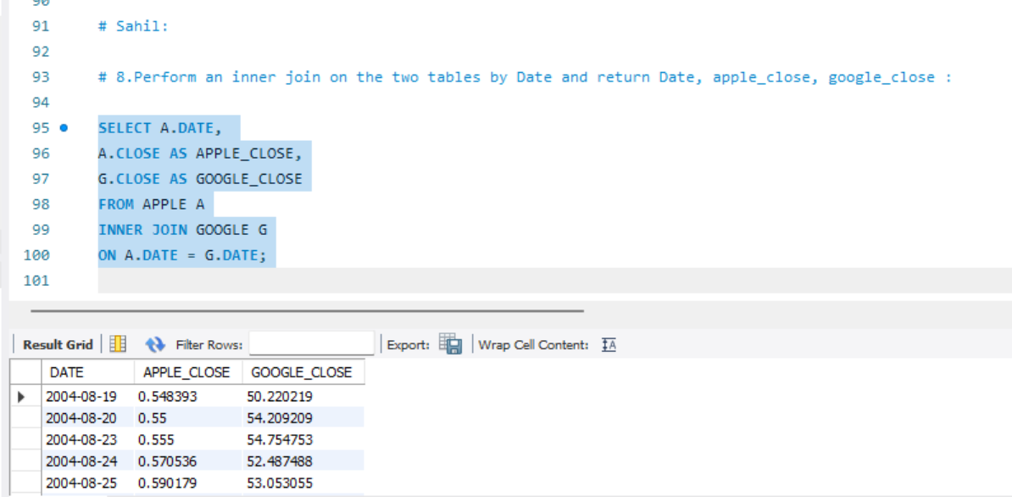

Slide 12
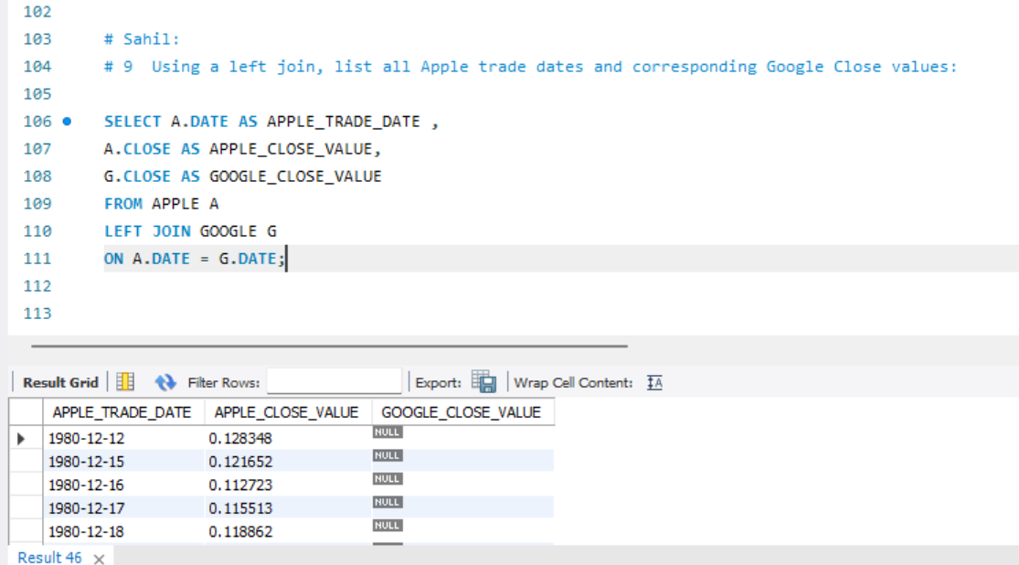

Slide 13
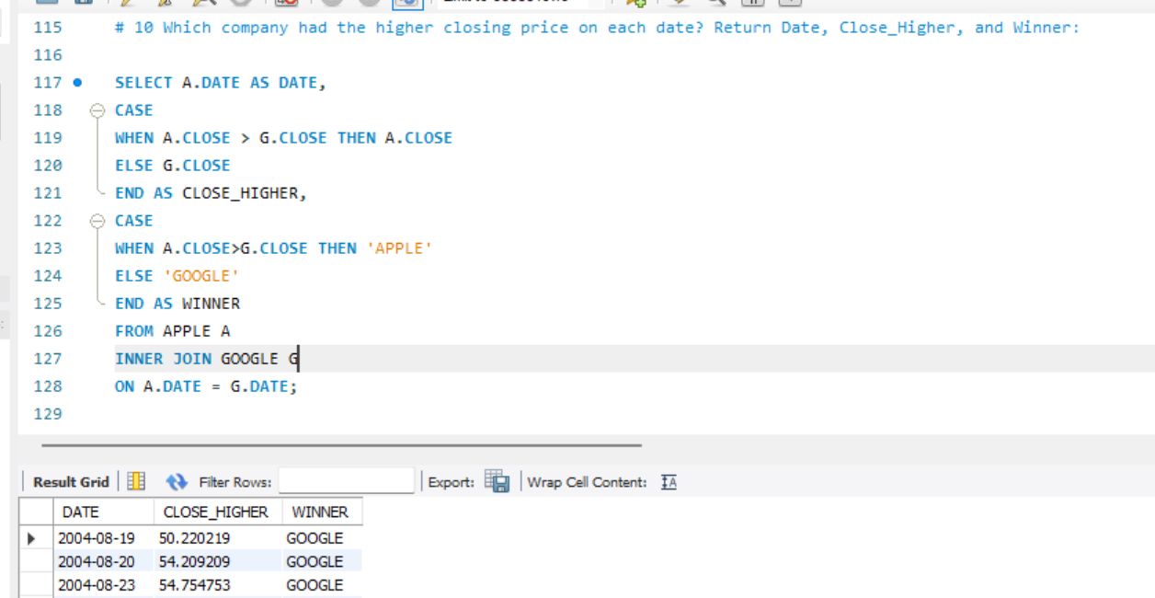

Slide 14
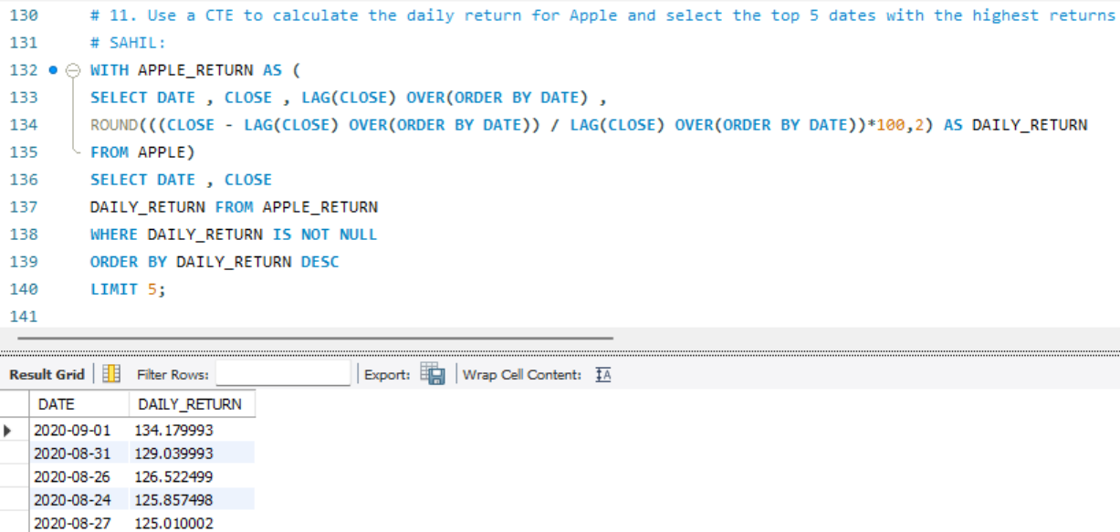

Slide 15
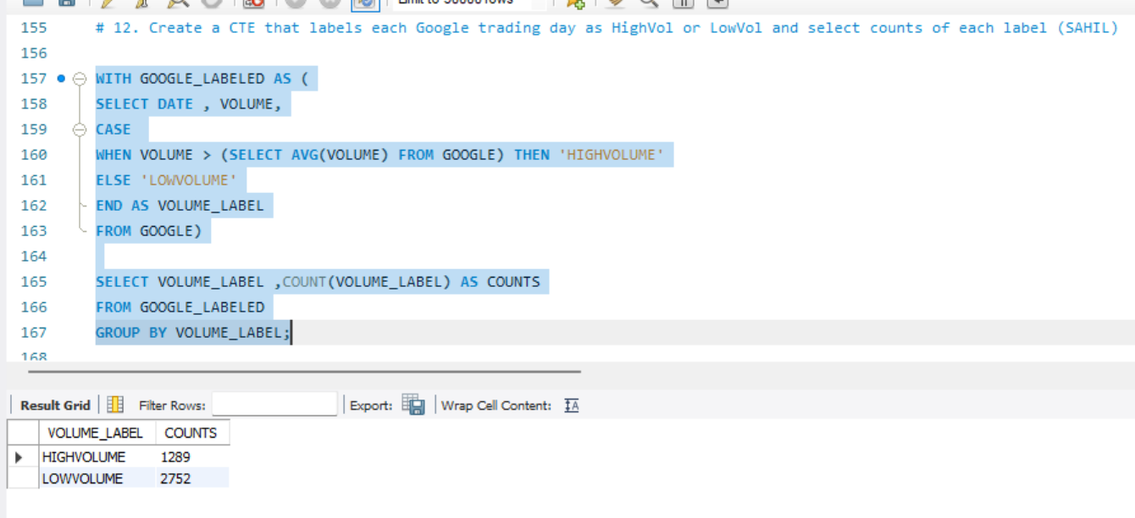

Slide 16
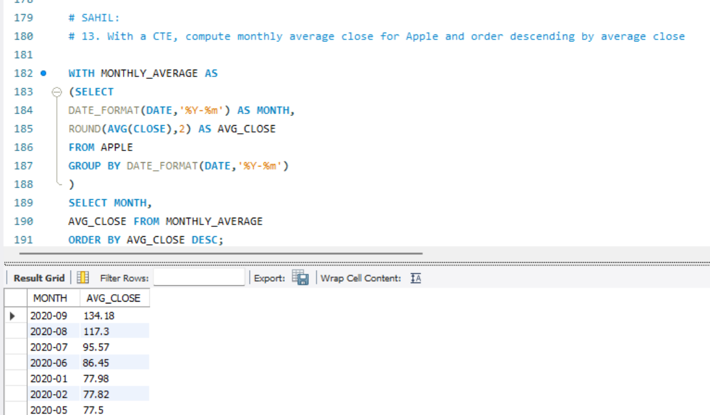

Slide 17
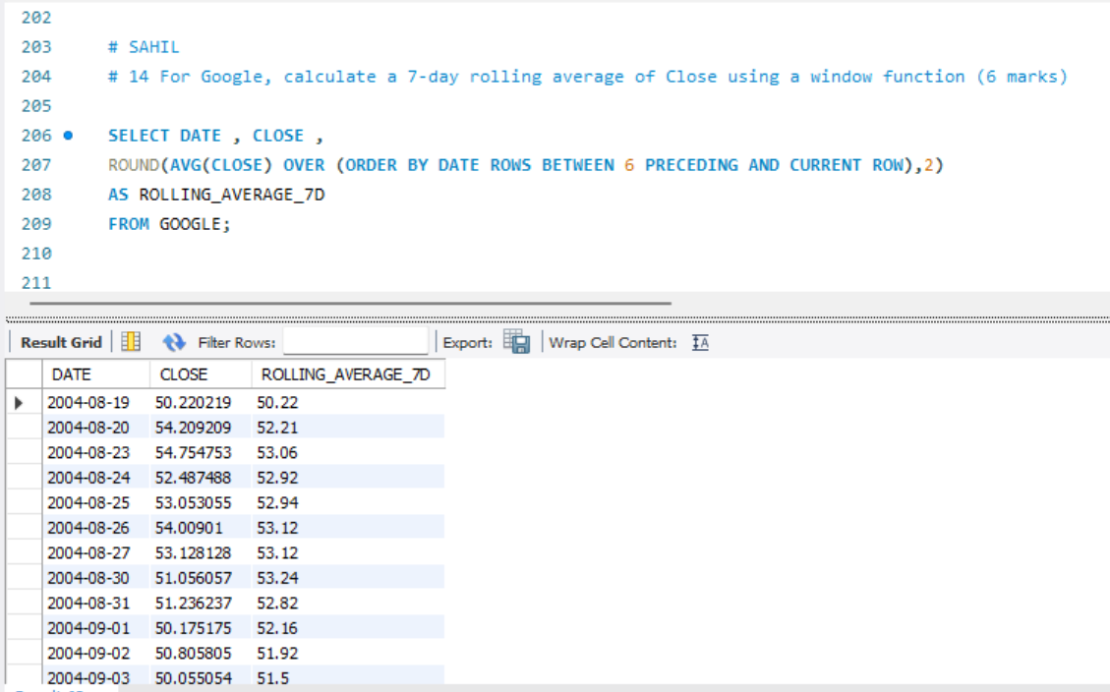

Slide 18
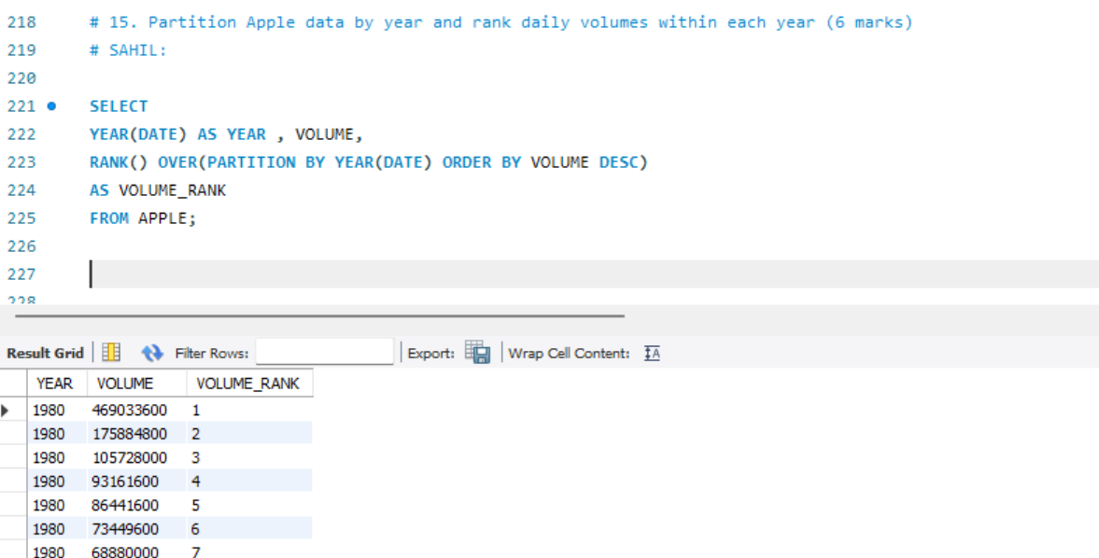

Slide 19
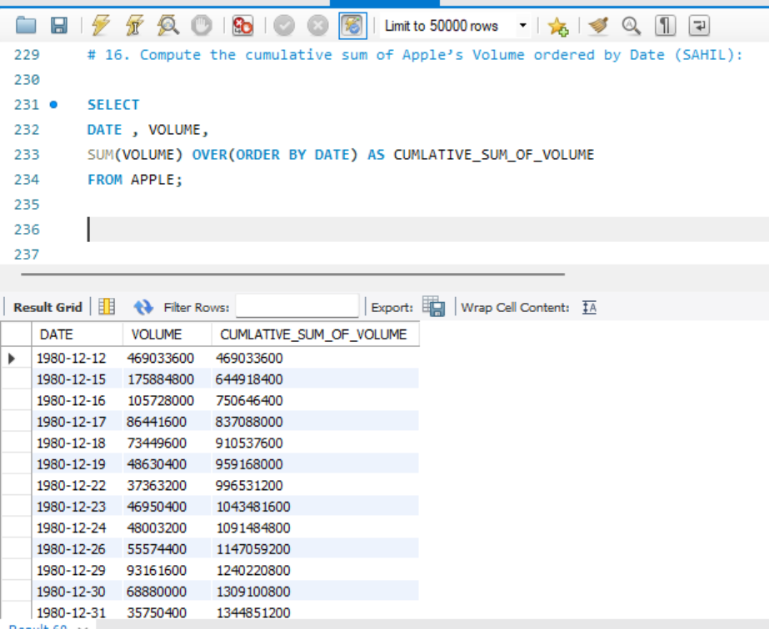

Slide 20
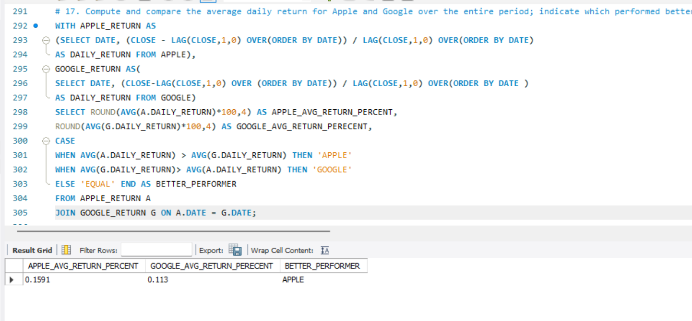

Slide 21
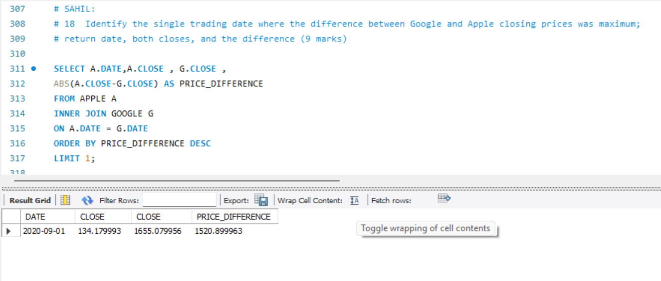

Slide 22
Key Insights :
Apple and Google stocks showed varying daily performance and trading volumes.
Google's average closing price was higher, but Apple had competitive daily returns.
Apple outperformed Google on several days in terms of closing price.
Google had more High Volume trading days, indicating greater market activity.
Monthly trends revealed strong performance periods for Apple.
The largest closing price gap between the two occurred on a specific date worth noting.
Overall, both stocks showed unique strengths—Apple in growth days and Google in price stability.

